Slide 1


COMPUTER NETWORKS LAB PROJECT
P2P
FILE SHARING SYSTEM
PRESENTED BY:
D. V. S. MALLIKARJUN (22VE1A6713)
M.ARAVIND KUMAR (22VE1A6736)
P.PRANITH REDDY (22VE1A6748)
R. AKHIL SAI (22VE1A6749)

Slide 2




PROBLEM
STATEMENT
In Computer Networking, P2P (Peer-to-Peer) is a file-sharing technology, that allows users to access mainly the multimedia files like videos, music, e-books, games, etc. The individual users in this network are referred to as peers. The peers request files from other peers by establishing TCP or UDP connections.

Slide 3

OVERVIEW OF P2P (PEER-TO-PEER) :
A peer-to-peer network allows computer hardware and software to communicate without the need for a server. Unlike client-server architecture, there is no central server for processing requests in a P2P architecture. The peers directly interact with one another without the requirement of a central server.
Now, when one peer makes a request, multiple peers may have a copy of that requested object. Now the problem is how to get the IP addresses of all those peers. This is decided by the underlying architecture supported by the P2P systems.

Slide 4

P2P ARCHITECTURE :
CENTRALIZED DIRECTORY ARCHITECTURE
In this architecture, one entity (the server) acts as the central point of communication and coordination. Clients connect to this central server to send or retrieve resources (e.g., files).
The Sender acts as a centralized server by setting up a socket and waiting for incoming connections.
The Receiver connects to this centralized server (using the hostname and port) to retrieve the file.

Slide 5
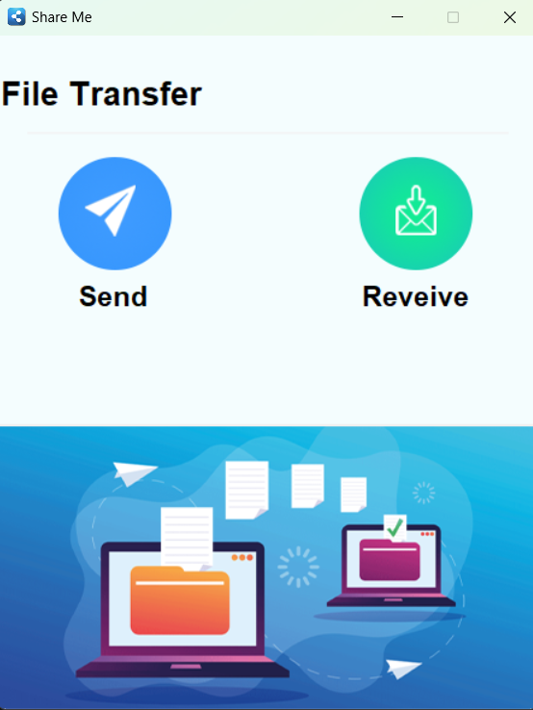
HOW DOES IT WORK ?
Scenario:
File: document.txt
Sender: Computer A
Receiver: Computer B
Network: Both computers are on the same Wi-Fi.

Slide 6
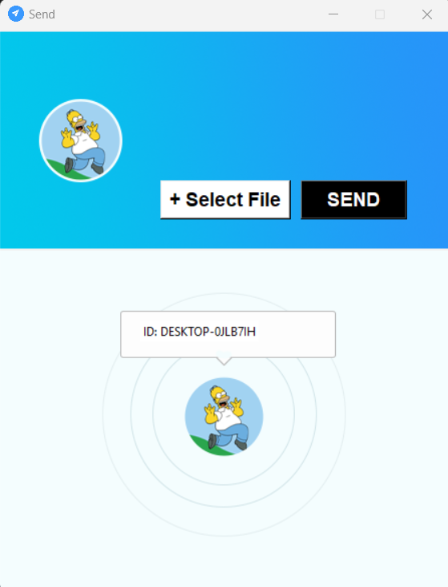
SENDER SIDE:
On Computer A (Sender):
Open the app and click Send.
Select document.txt and note down the hostname (e.g., DESKTOP-123ABC).
Wait for Computer B to connect, then click SEND.

Slide 7
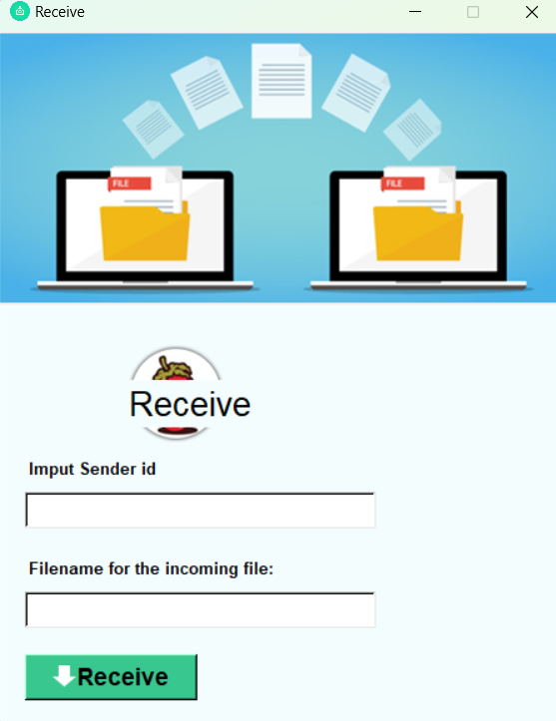
RECEIVER SIDE:
On Computer B (Receiver):
Open the app and click Receive.
Enter DESKTOP-123ABC as the sender's ID.
Specify the save location and filename (e.g., received_document.txt).
Click Receive.

Slide 8


CONCLUSION:
This project demonstrates a practical implementation of a file transfer application using Python, leveraging the Client-Server Architecture. The application provides a straightforward and user-friendly interface for sending and receiving files over a local network. By utilizing Python's socket library for network communication and tkinter for the graphical user interface, the project efficiently handles real-time file transfer operations.

